Slide 1

Note: The data and information in this document is reflective of a hypothetical situation and client. This document is to be used for KPMG Virtual Internship purposes only.
Sprocket Central Pty Ltd
Data analytics approach
Nikhil Neve
KPMG Data Analytics Consulting Team
Virtual Intern
linkedin.com/in/nikhil-neve-463408247

Slide 2
Agenda
Introduction
Data Exploration
Feature Selection
Model Development
Interpretation
Future Work

Slide 3
Introduction
Synopsis:
Specializing in high-quality bikes and accessible cycling accessories for riders, Sprocket Central Pty Ltd offers a range of products to meet the needs of cyclists. By analyzing their existing customer dataset to determine customer trends and behavior, their marketing team is looking to boost business.
A labelled dataset consisting of customer demographic, customer address, and transaction data was given.
Identify
Collect
Clean
Aim:
Analyze
The objective of this analysis was to recommend which of the 1000 new customers, who were given separately, should be targeted to drive the most value for the organization.
Interpret

Slide 4
Data Exploration
Data Pre-Processing
Three datasets of existing customers are given to us which initially consist -
Transaction (20000 x 13), (Total Missing Values- 1542 )
Customer Demographic (4000 x 13), (Total Missing Values- 1763 )
Customer Address (3999 x 6), (Total Missing Values- No null values )
We have performed Data Quality Assessment on it as per 1st task. The data cleaning, data reduction, and data transformation process of data mining are done. Missing data is checked and filled with an appropriate or dropped whenever required.
Afterward, these three datasets are merged on a common column called “customer_ID” and performed data cleaning and preparing data to enable feature engineering to work on module 2.
Feature Engineering
The ‘age’ column is added from ‘DOB’ column.
Created new column ‘transaction_month’ column using ‘transaction_date’ and “profit” column from “list_price” & “standard_cost”.
Unknown columns deleted from New Customer List.

Slide 5
Feature Selection
Features Selection
Feature Selection is the process of selecting a subset of relevant features for use in model construction.
Gender
Age Range
Past 3 years Bike Related Purchase
Job Industry Category
Customers Own Car
Wealth Segment

Slide 6
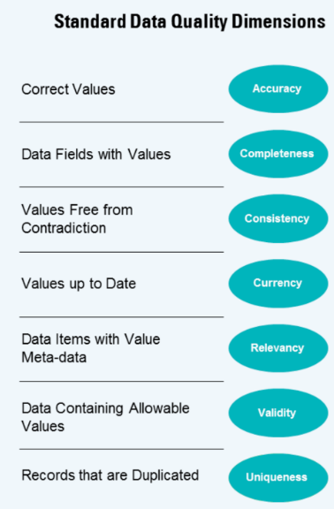
Data Exploration
Summary of Data Quality Assessment
Dataset No | Dataset Name | Data Quality Issue
1 | Transaction | Completeness- Missing Values found in data.
 |  | Validity- “product_first_sold_date” is not a date.
 |  | Accuracy- Profit data could be included for analysis.
2 | Customer Demography | Completeness- Missing Values found in data.
 |  | Consistency- “gender” column has inconsistent values
 |  | Validity- “default” column has invalid data.
 |  | Timeliness- “DOB” has one outlier for
3 | Customer Address | Consistency- “state” column has inconsistent data.
Appropriate actions on the datasets were taken for further analysis.

Slide 7
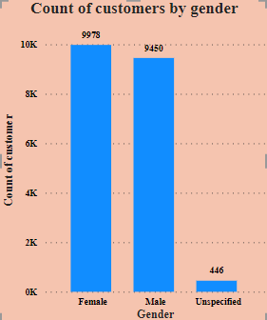
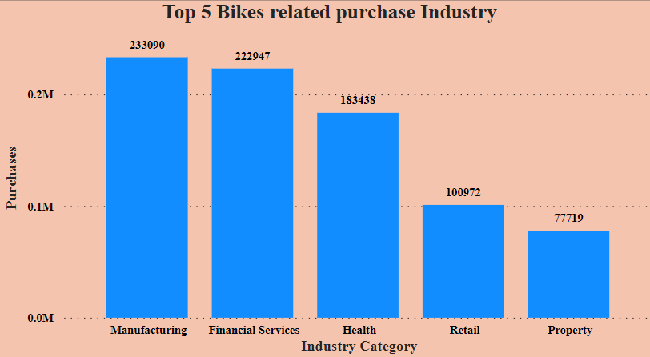
Data Exploration
Customers by Gender
Top 5 Bikes Related Purchase by Industry
Based on the information presented in the bar chart, we can deduce that our customer base consists of a higher number of females than males, and the dataset also includes 446 customers whose gender is not specified.
The vertical bar chart below shows the top 5 industries, out of 9 total, that contributes the most to purchases of bike-related products.

Slide 8
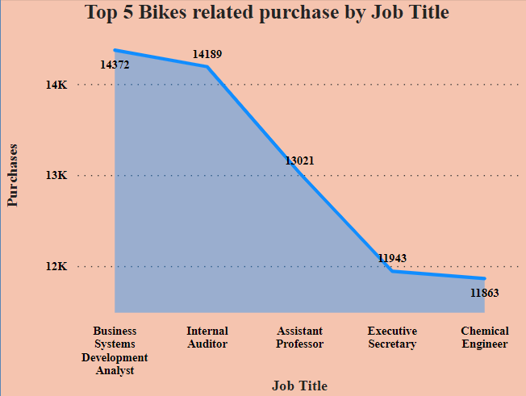
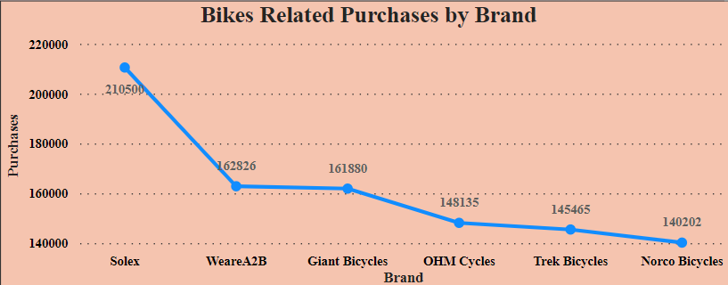
Data Exploration
Top 5 bikes related purchases by Job Title
From the area chart, it can be inferred that the group of Business System Development Analysts has made the highest number of purchases for products related to bikes.
Top 5 bikes related purchases by brand
Based on the information provided in the area chart, it can be inferred that the brand "SOLEX" has been purchased the most number of times in relation to bikes.

Slide 9
Model Development
RFM Analysis
As per our business requirement, RFM analysis is performed on data.
The RFM analysis technique is used for targeted marketing based on the metrics of Recency, Frequency, and Monetary. It helps to determine which customers are high-value to the industry and should be targeted. The model uses RFM scores to segment customers based on their transaction history.
Key metrics:
Recency: When was the customer's last transaction or interaction with the business?
Frequency: How often does the customer transact or interact with the business?
Monetary: How much money has the customer spent on transactions or purchases?

Slide 10
Model Development
RFM Calculations
Recency is calculated from the reference date 2018-3-31
df['recency']=(cd_ts-df['transaction_date']).dt.days
Frequency is calculated as the number of times customers purchase different items.
frequency_df = df.groupby('customer_id')['product_id'].nunique().reset_index()
Monetary (Total money customer spent on purchases over a period of time.)
monetary_df = df.groupby('customer_id')['profit'].sum().reset_index()\
RFM score
rfm_score = recency_score * 100 + frequency_score * 10 + monetary_score
Customer_Segments=['Need Attention','Low Value Customer','Potential Customer','high Value Customer','Loyal Customer’]
mergedRFM['Customer_Segment']=pd.cut(mergedRFM['RFM_Score'],bins=[000,112,223,334,445,556],labels=Customer_Segments)

Slide 11
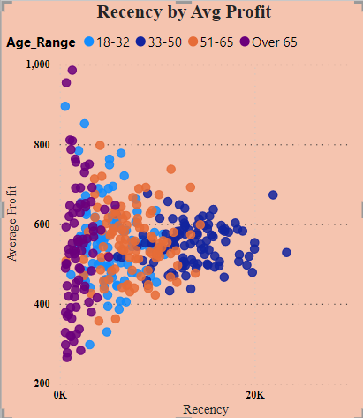
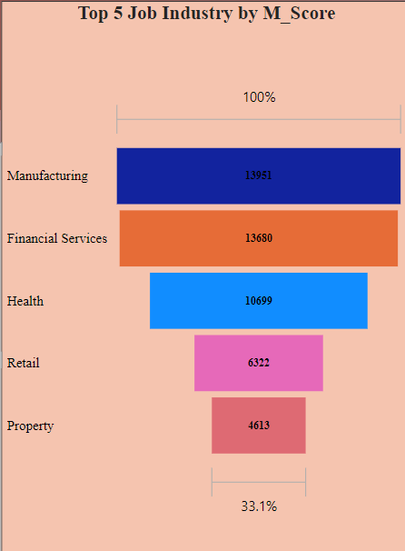
Interpretation
Recency Vs Avg Profit
This scatter plot displays the relationship between ‘recency’ and “avg profit” of products purchased over the “age_range”. From the plot, it can be inferred that customers in the age range of 33-50 years are more recently active (engaged) customers and generate a good amount of profit.
Top 5 Industry by M_Score
Based on the scatter plot showing the relationship between "M_score" and "Top_5_job_industry", it appears that customers in the Manufacturing and Financial Services industries have a higher M_score, indicating that these industries may have a higher likelihood of engaging in earnings manipulation.

Slide 12
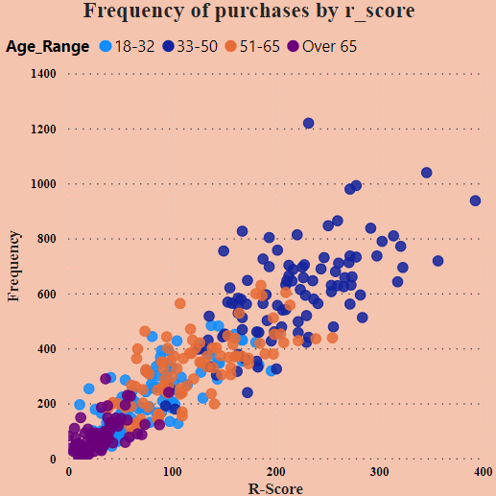
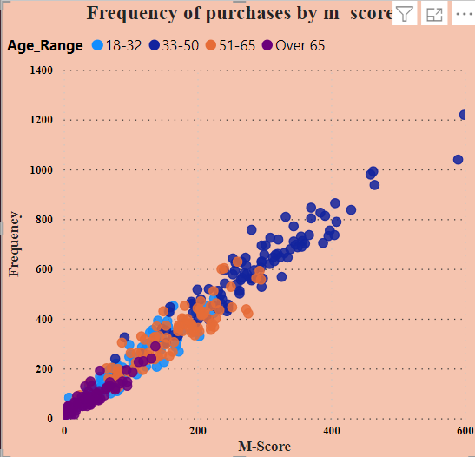
Interpretation
R_Score Vs Frequency
This scatter plot displays the relationship between ‘r_score’ and “frequency” of products purchased over the “age_range”. From the plot, it is understood that customers in ‘age_range’ of 33-50 years have a maximum recency score and their frequency of purchasing products is also high.
M_Score Vs Frequncy
This scatter plot displays the relationship between ‘m_score’ and “frequency” of products purchased over the “age_range”. From the plot, it is understood that customers in ‘age_range’ of 33-50 years have a maximum monetary score and their frequency of purchasing products is high too.

Slide 13
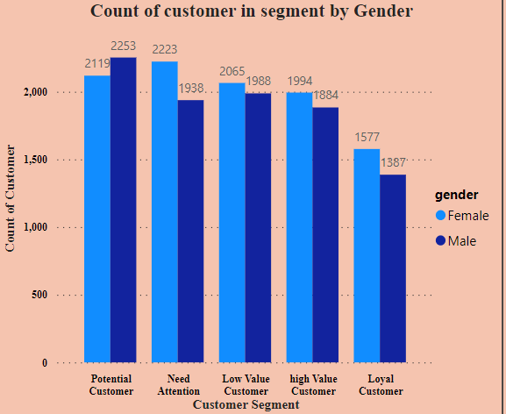
Interpretation
Customers by Customer Segment
As per our RFM analysis and Customer Segmentation on existing customers, this stacked column bar chart indicates that we have the maximum number of customers (4372) in ‘Potential’ segment firstly, ‘Need Attention’ secondly (4161), ‘Low-Value Customer’ category thirdly (4053), ‘High-Value’ fourthly (3878) and then there are 2964 ‘loyal’ customers.
Note: We haven’t considered customers whose Gender is Unknown.

Slide 14
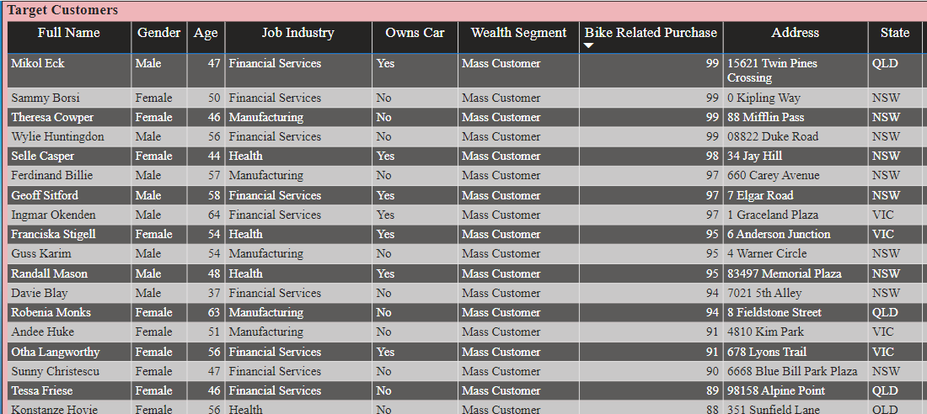
Interpretation
After analyzing our existing customer base, we have identified a list of 100+ customers who are likely to provide the most value to our company based on their demographic data. We recommend targeting these customers for our marketing efforts.
The following snap contains some of those customers

Slide 15
Future Work
The followings are some observations and suggestions for future work that can be carried out.
The details of variables in datasets were not provided, it will be much easier to understand if provided.
As per state records, the highest number of bikes are purchased in NSW state.
The mass customer wealth segment is found to be purchasing more items.
Customers in the age range of 33-50 years have made more purchases related to bikes.
Customers in the Manufacturing and Financial Services Industry are the most valuable customers.
Potential Customer Segment has the highest customer value.
Focusing on customer experience, utilization of various marketing channels like email, social, and content marketing, and regularly testing new strategies for growth will might help for business growth
Customer Income, Product Rating and Review, and Customers Sentiments are additional variables that can be added to the dataset.

Slide 16
Thank You!

